Slide 1
Appdev and SecArch – Building a better tomorrow Together!
By
CRob
Melanie McKean
Notes:
CR

Slide 2
Biographies
Christopher Robinson (aka CRob) is the Information Security Architect for Westfield Group. With over 18 years of Enterprise-class engineering, operational and leadership experience, Chris has worked at several Fortune 500 companies with experience in the Financial, Medical, Legal, and Manufacturing verticals. CRob has been a featured speaker at Gartner’s Identity and Access Management Summit, RSA, as well as several Tivoli Pulse and Splunk conferences. CRob is active in the Information Security community. He is the Education Officer for the Cleveland (ISC)2 Chapter.
Melanie McKean is an Application Architect at Westfield Group, with the focus on people, processes, and technologies for distributed development on the JEE platform. She is an integral part of ensuring the promotion and implementation of security throughout the software development lifecycle for Westfield. Her most recent assignment on an Enterprise-focused system update included the secure propagation of identity between applications and services through the implementation of several IBM security tools working in concert with WebSphere Application Server (WAS).
Notes:
CR / MM

Slide 3

in the beginning…
Application Development Says……..
Information Security Says……

Slide 4

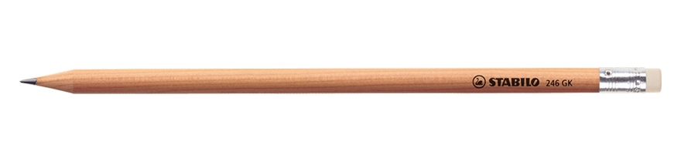
OWASP To 10 Web Application Security Risks
- WebGoat Hands-On Learning
- Cheat Sheets
Kerberos / SPNEGO
LTPA – Lightweight Third-Party Authentication
TAI – Trusted Association Interceptor
Single Sign-On
AccessManager
Digital Certificates
Digital Signing
SSL
PKI
SAML
SAMM
Encryption
Symmetric / Asymmetric
WS-Security
WS-Secure Conversation
WS-Federation
WS-Context
WS-Policy
WS-Authorization
WS-Trust
WS-Privacy
Authentication Service
Authorization Service
Audit Service
Web Service Gateway

Slide 5
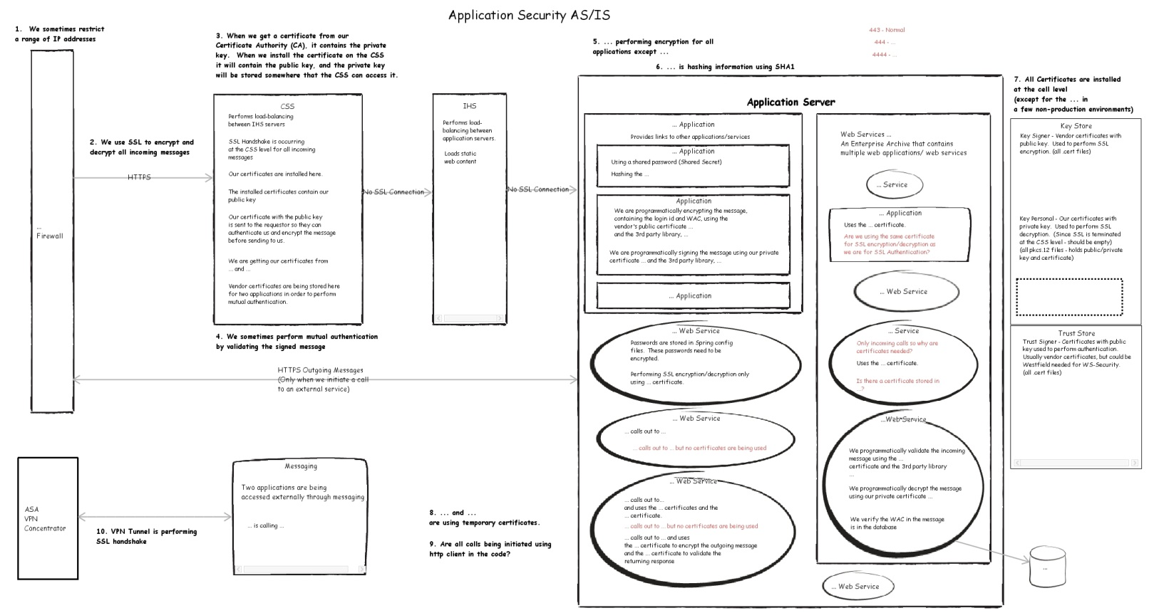
“The … application is hashing information using SHA1”
“We sometimes restrict a range of IP addresses”
“We use SSL to decrypt all incoming messages”
“We are programmatically signing the message using…”
“Applications … and … are using temporary certificates”
“We sometimes perform mutual authentication by validating the signed message”
“Two applications are being accessed externally through MQ”
“Passwords are stored in Spring config files”
“VPN Tunnel is performing the SSL Handshake”
“SSL Handshake is ocurring on WAS when we initiate the out-going message”
“SSL Handshake is occuring at the CSS level for all incoming messages”
“WAS is performing encryption for all applications except…”

Slide 6
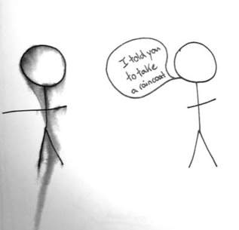
Milestone 1….

Slide 7
New claims management system
ARCHITECTURAL AND SECURITY REQUIREMENTS
Simplified Sign-On
Propagate user identity between systems
Federate user identity with vendor systems
Secure Integrations

Slide 8
Simplified Single sign-on
Complex business processes require the user to interact directly with multiple systems as part of the normal workflow. Simplified sign on improves user efficiency, which is a part of the ROI on modern systems. XSA simplified sign on allows for a common user (web) sign on (SSO) to multiple systems as well as common session management and coordinated session recovery between systems

Slide 9
Implementation of Single sign-on
Proxy Server
WebSEAL
Passing credential information
eTai+ to establish JAAS Subject
LTPA Token to establish JAAS Subject
Authentication
TDS to Active Directory
Coarse Grained Authorization
ACLs – TDS

Slide 10
Propagate user identity between systems
Enterprise systems are integrated using services and SOA to enable complex business processes and information sharing. In some cases there is a business need to propagate user context between systems as part of the service call since the user has different levels of authorization in those systems. The identity must be propagated at a system level that is transparent to the user.

Slide 11
Identity propagation
WS-Security
SAML 2.0
Security in the Infrastructure
Industry Standards – JAX-WS
JAAS Subject
Encryption / Signing
Local token validation – exception GWCC
Single Point of Token Generation
Policy Sets and Bindings
App Configs
XML files

Slide 12
Federate user identity with vendor systems
Our business processes demand secure, real-time integration of our internal systems with vendor and cloud-based systems. Identity federation enables sharing and managing identity information with vendors to allow for simplified sign on and propagating user identity between internal and external systems.

Slide 13
User identity federation
Web Applications
Required additional login
Special Case using WebSEAL
Web Services
Web Services Gateway
Outbound
Inbound Integration with FIM
SFTP
FTP Server
Inbound Integration with FIM
Future Federated User Identity Solutions

Slide 14
Secure integrations
It is Westfield security direction to protect sensitive data shared between enterprise systems and with external systems through secure (authenticated, access-controlled and auditable) interactions between systems.
Notes:
CR
?

Slide 15
Enterprise security goals / constraints
Integration to external systems and vendors is through secure, fit-for-purpose, gateways (DataPower, Sterling MFT, WebSEAL) and not directly. Move toward identity federation with vendors and partners.
Access to Westfield systems and Information from external systems, partners and customers will be controlled through appropriate gateways, never directly to a Westfield system.
Shifting away from “trusted system” model for internal application integration to a cross-system authentication (XSA) model. Enforce security policy at all levels.
Security policy enforcement will be externalized (removed) from application code into the XSA framework and middleware. XSA provides the security policy decision points for Westfield’s web and services-based systems both internal and externally
Where needed, enable secure SSO and token-based user (or system) identity propagation to authenticate between systems.
Wherever possible leverage non-proprietary, extensible standards to enable secure integrations (WS-Security, SAML 2.0 tokens, etc).
Move away from flat, open network to a segregated network utilizing encryption.

Slide 16
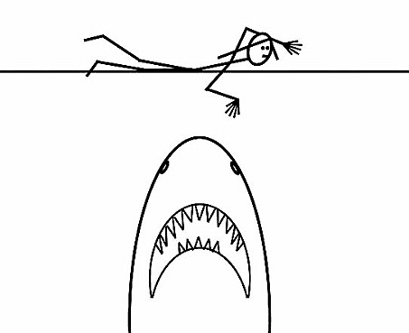
Milestone 2…

Slide 17
…Security Architecture Roadmap slides go here
;-)
Notes:
CR

Slide 18

Herding the cats
Unlike a lot of areas in IT or InfoSec, SecArch has a VERY broad reach.
SecArch = Enterprise Architecture, but for security for EVERY platform, system, app
Notes:
CR

Slide 19
You say the word “control” as if I had any…
Notes:
CR

Slide 20
“distributed security”
A concept is born…..
Notes:
CR

Slide 21

How we are getting there
Notes:
CR

Slide 22
AppDev / SecArch Initiatives
2014 / 2015 Initiatives
Security and the SDLC
Scanning Tools
Security Reference Architecture
And Beyond
Certificate Management
Remediation of existing applications and services

Slide 23
Security and the SDLC
SDLC is critical (and not JUST for Development Projects)
Overview of Tasks
Artifacts and Processes
References and Documentation
Education
Target Audiences

Slide 24

Scanning Tools
Helping build better code
Static Analysis Scanner (SAS) to find coding problems/security flaws
Dynamic Analysis Scanner (DAS) to find vulnerabilities in code in runtime environment
Education
Fun Fact: Cost to fix defect in development: $80. Cost to fix defect in Production: $7,600*
*Source : IBM
Notes:
MM

Slide 25
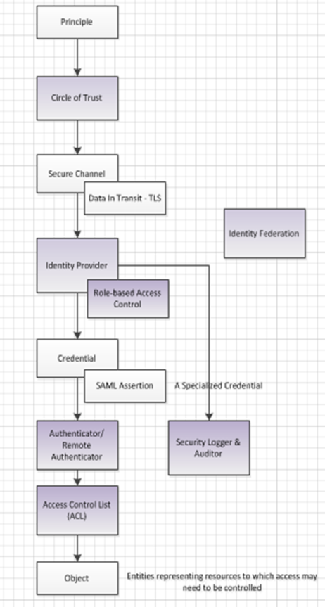
Security Reference Architecture
Security Patterns Defined
Standards / Guidelines Created
Security Reference Architecture
Web Access Management Reference Architecture
Web Service Access Management Reference Architecture
Exceptions documented in Project Solution

Slide 26
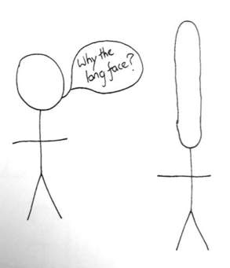
Milestone 3

Slide 27

Questions?
Notes:
CR / MM

